Slide 1
Data-driven Approach to Improving Anesthesia Safety in Veterinary Medicine
Emi K. Saito, VMD, MSPH, MBA, DACVPM (Epidemiology),
Kseniya Topdjian,
Marissa Rothenbaum, DVM
Banfield® Pet Hospital, Central Team Support, Veterinary Affairs
Vancouver, Washington (USA)

Slide 2
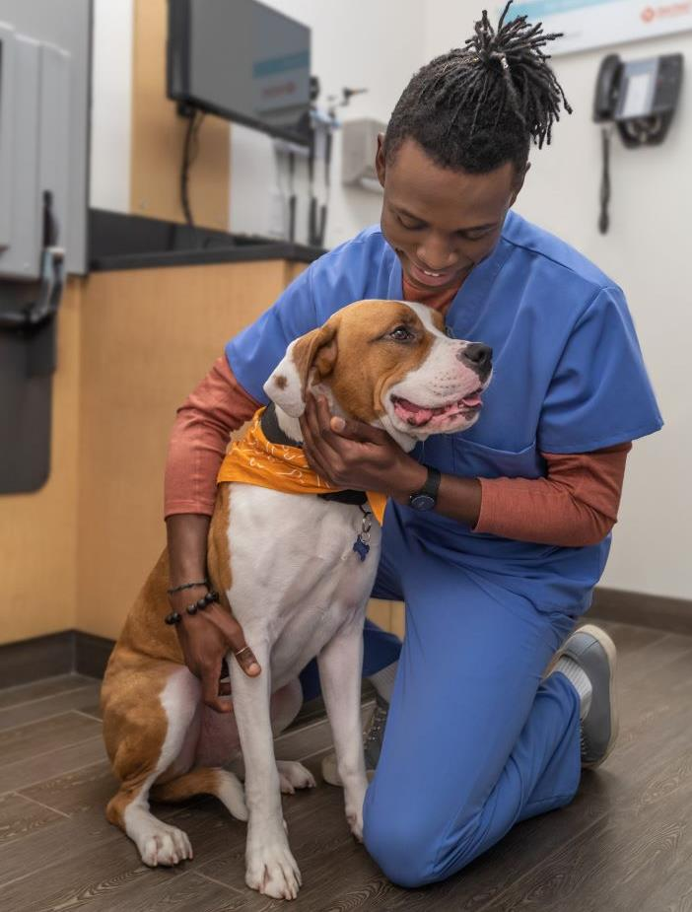
Overview: Banfield® Pet Hospital:
Founded: 1955, Portland OR (USA)
> 1,000 veterinary hospitals in 44 states, DC, PR, UNAM
> 3,600 veterinarians
Preventive care focus
Over 2.8M dogs and 0.6M cats
> 9M visits

Slide 3
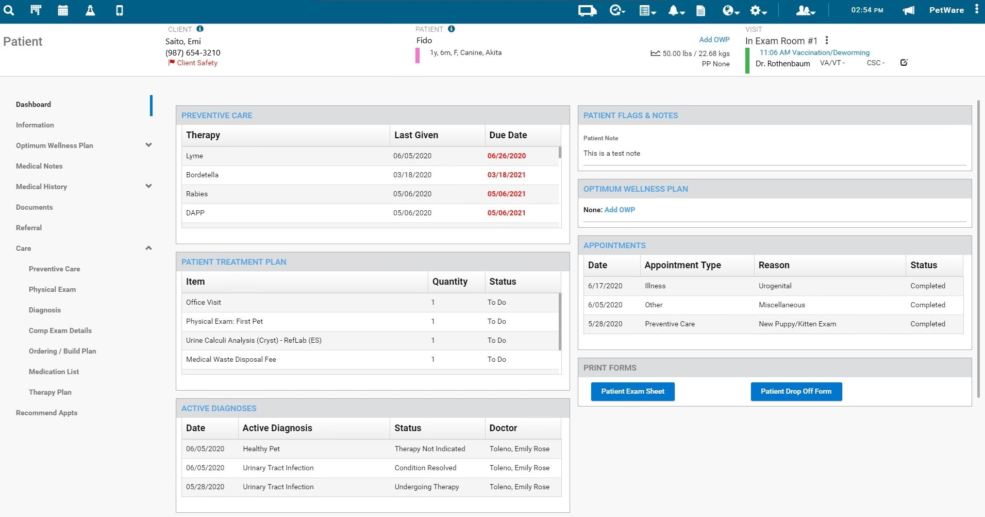
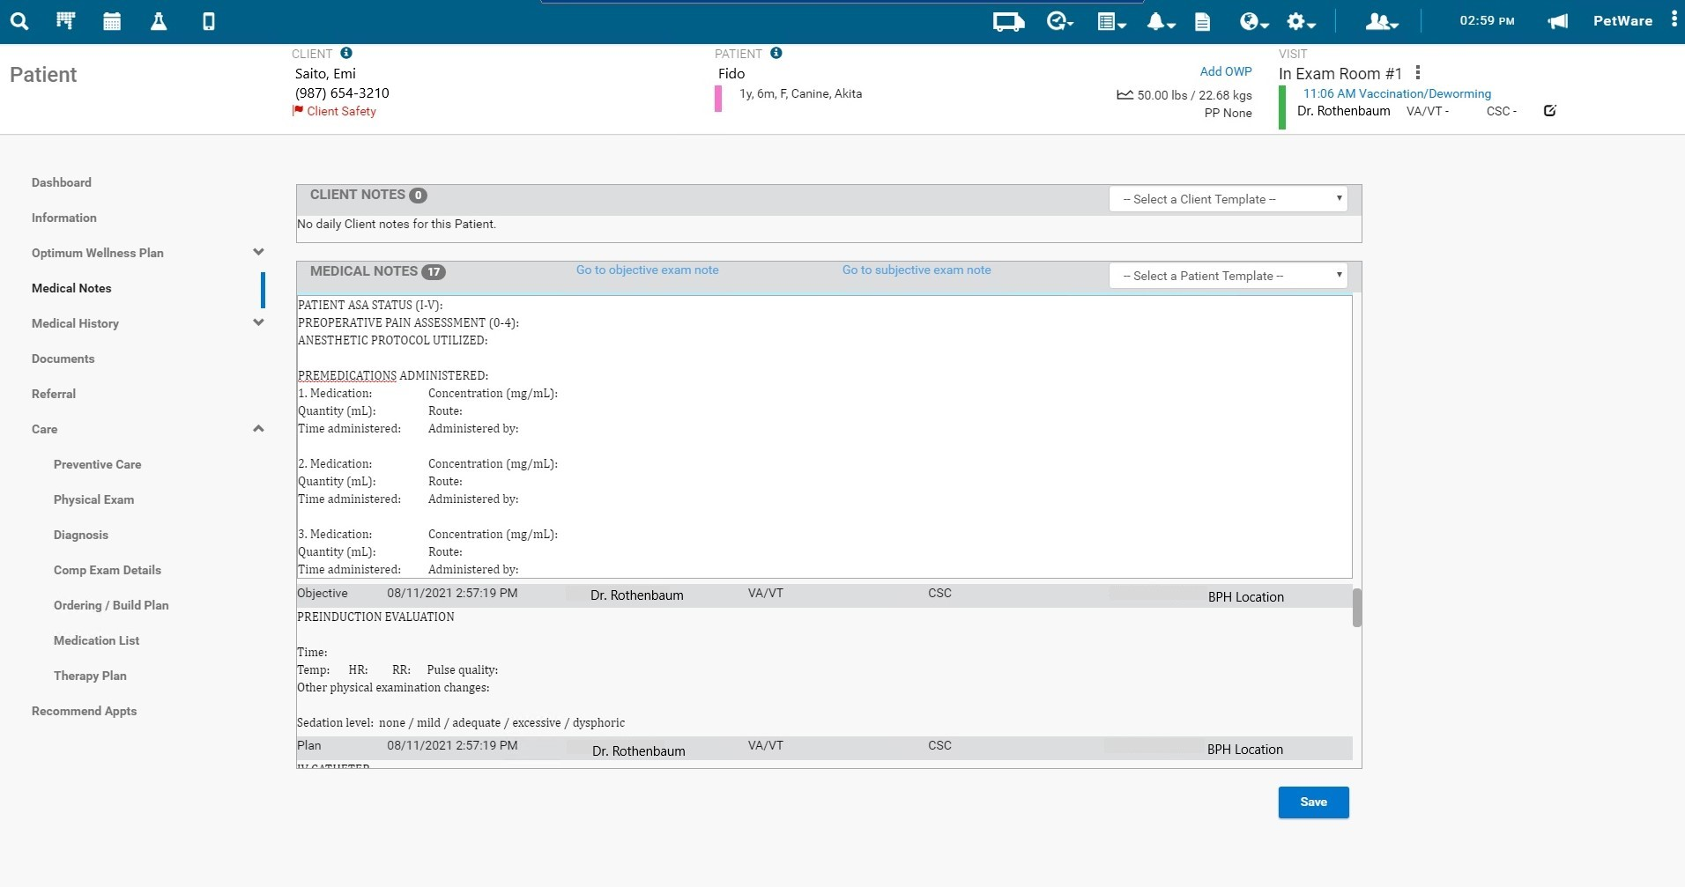
Overview: PetWare®
Since mid-1990’s
>20M dogs and cats
Pet Health trends
State of Pet Health® Reports
Epidemiologic research
ID risk factors
Medical quality, patient outcome improvement
Veterinary Emerging Topics (VET)™ Report
Anesthesia safety

Slide 4
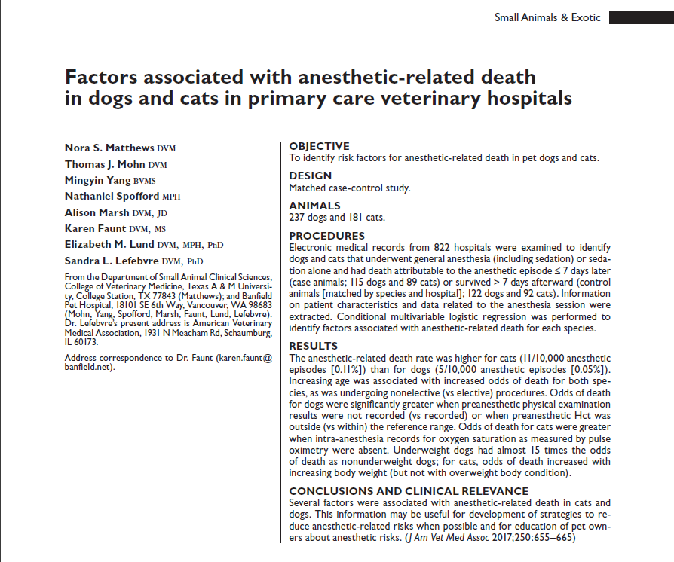
Anesthesia-related mortality rate
2017: Banfield study
Dogs: 0.05%, Cats: 0.11%
RF: ASA score , age, type of procedure (elective vs non), Hct outside of reference range, BCS
Chasing zero….
At/lower than reported elsewhere
Anesthesia = riskiest service
>1M anesthetic procedures
 | Anesthetic Mortality
 | Canine | Feline
Matthews et al. (2017) | 0.05% | 0.11%
Dyson et al. (1998) | 0.11% | 0.1%
Brodbelt et al. (2008) | 0.17% | 0.24%
Levy et al. (2017) | 0.009% | 0.05%

Slide 5
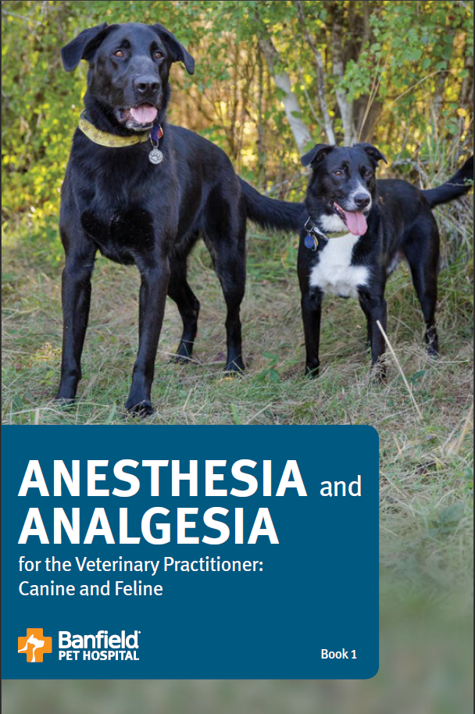
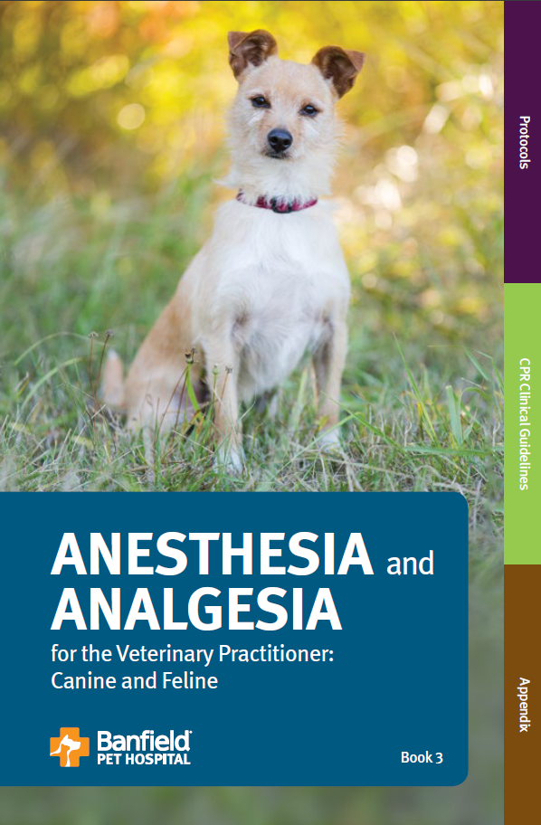
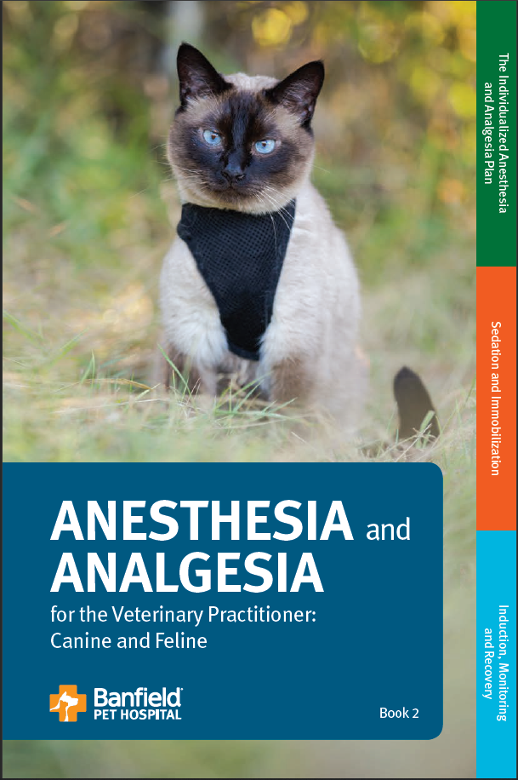
Anesthesia & Analgesia for the Veterinary Practitioner: Canine and Feline
Medical quality standards and protocols developed based on fundamentals of quality and medical best practices
Job aids:
- equipment checklist
- pre-anesthetic clinical pathology evaluation
Anesthesia dosing calculator
Freely available on Vet.Banfield.com/Exchange

Slide 6
Embedding and sustaining change
Clinical Essentials and Best Practices:
Created clear expectations for hospital teams
Launched P11 2017
Adoption and accountability
Provided 6 months for teams to build compliance
Annual technical audit program launched P4 2018
Change management through anesthesia-related Periodic Focus Areas and hospital checklist – launched P10 2018

Slide 7
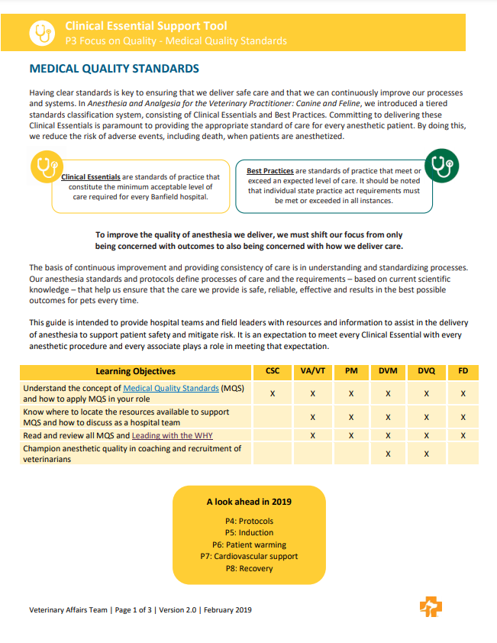
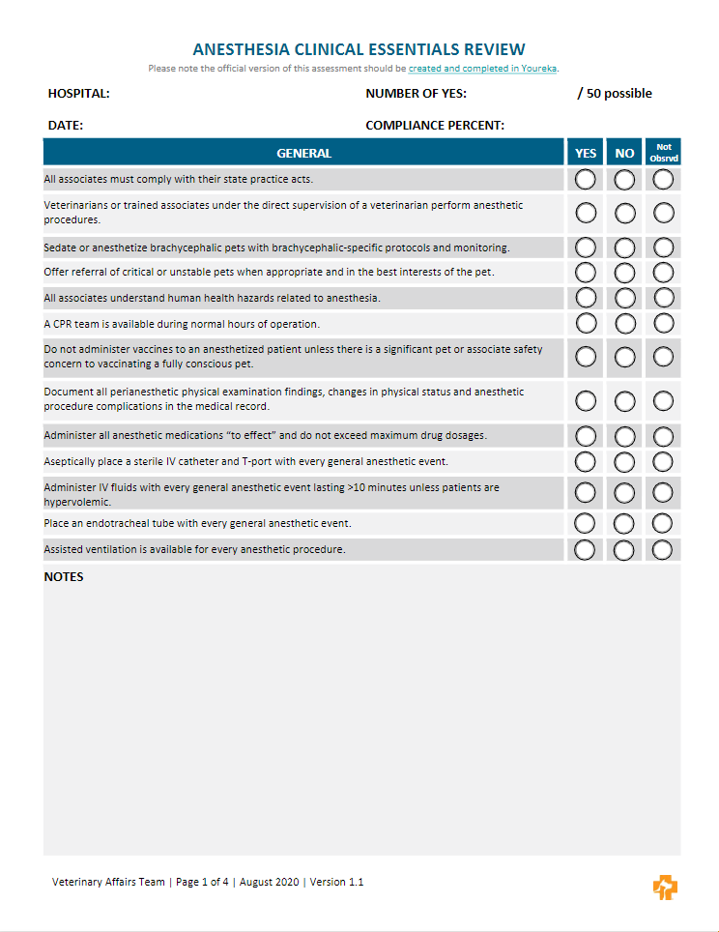
Example Change Management Tools

Slide 8
Monitoring anesthesia-associated mortality

Slide 9
Banfield’s EMR and Reporting
Petware®
Oracle Database
Microsoft PowerBI

Slide 10
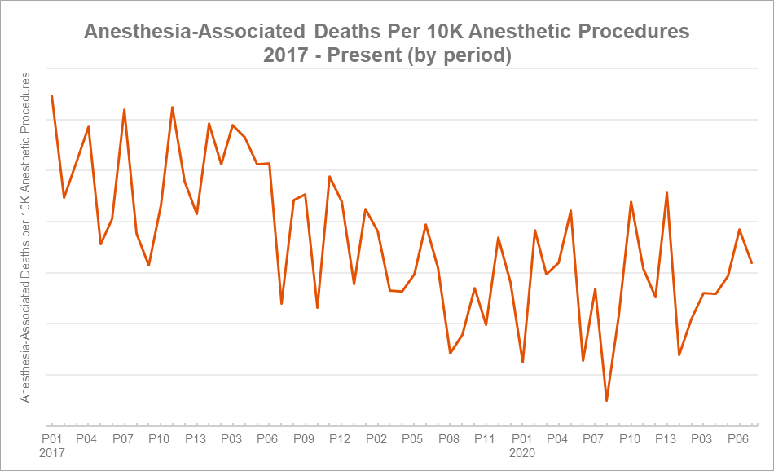
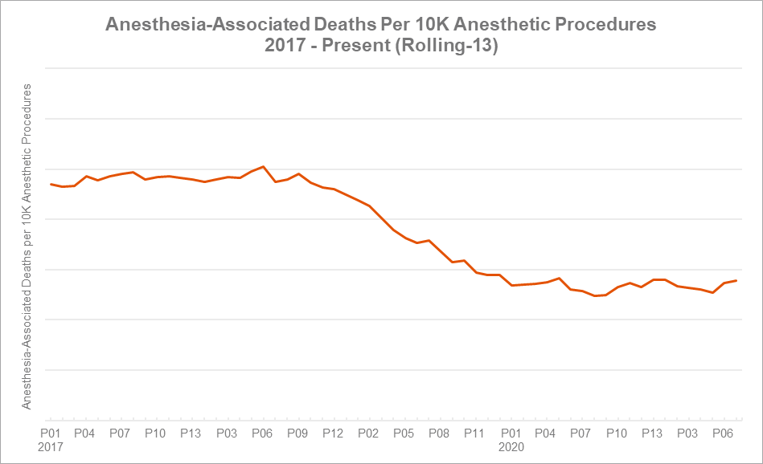
Anesthesia-Associated Mortality Rate (AAMR)
Chart A: Practice-wide AAMR by period
Normalize data per 10K procedures
High variability due to small number of incidences. (Chart A)
Add another layer: sum of deaths/procedures for past 13 periods provides a visible impact. (Chart B)
Chart B: Practice-wide AAMR rolling-13 period average

Slide 11
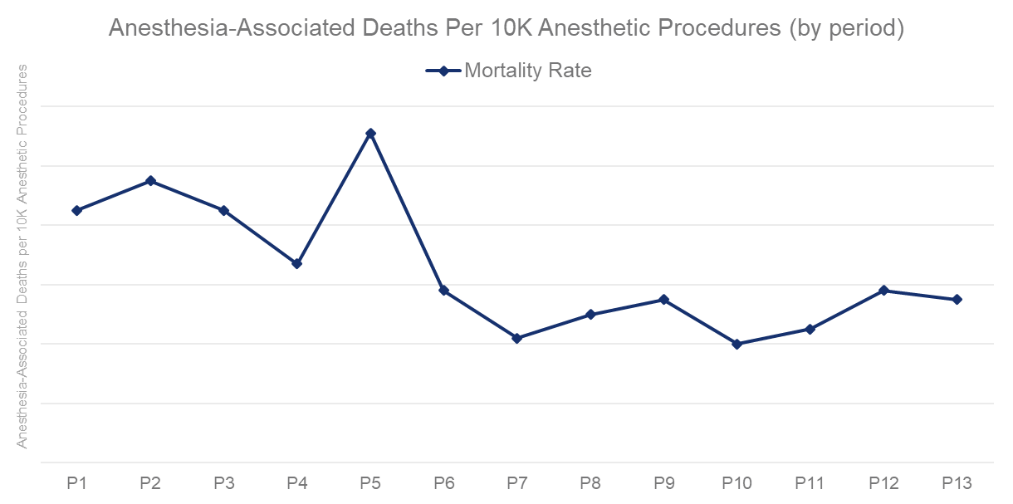
AAMR – Continuous Improvement
Process Behavior Chart
Look for 3 anomalies:
1. Limit breach: Any data point outside of the upper and lower limits.
#1
#2
2. 3 of 4: Three out of four consecutive data points are closer to the Upper/Lower limit than they are to the Central limit line.
#3
3. 8-point: Eight consecutive points on the same side of the central limit

Slide 12
Systems thinking to support hospital teams

Slide 13
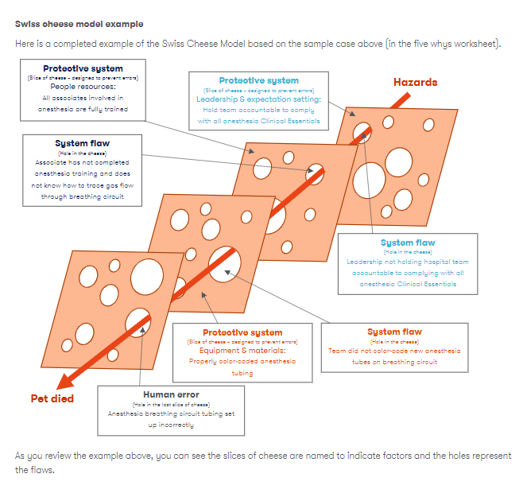
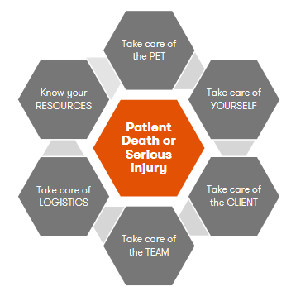
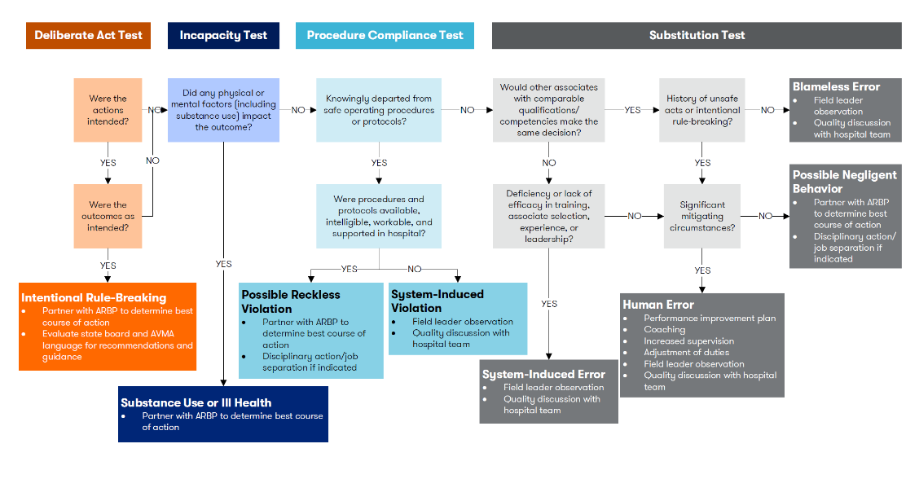
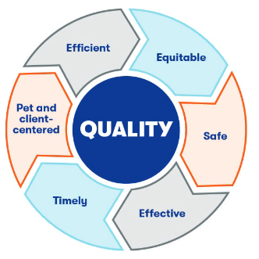
Systems thinking in adverse events
Culture of Safety – 2015 roadshow to build awareness and culture
Hospital input to drive continuous quality improvement – launched 2016
Associate empowerment
Stop the line
CUS communication guide
Hospital tools
Local vs. central issues
Quality Toolkit
Central team support tools
Root cause analysis (RCA)
Failure Mode and Effects Analysis (FMEA)
Fault Tree Analysis
Domains of Quality

Slide 14
Clinical Learning and Support Process (CLASP) - 2019
Clinical Learning
Associate Support
Decentralized exploration of adverse events
High-level RCA performed by local medical leadership
Investigator being closer to the event increases accuracy of identified root causes
Categorization of sentinel event type
Allows for exclusion of non-anesthesia-associated mortality cases (e.g. unrelated trauma, medical record documentation errors)
Recognizes risk of associate mental/emotional impact of adverse events (second victim)
Prioritizes psychological safety over clinical learning
Facilitates open, team wide discussion of events to support Culture of Safety

Slide 15
Continuous Improvement and Next Steps
Barriers/gaps in providing standard of care
Sharing best practices – local & practice-level
Dashboard – to support veterinary leaders and their hospital teams
Data analyses to identify other opportunities to reduce risk
Feline risk
Risk factors for feline mortality
Using AI to predict feline risk in real time?

Slide 16
Thank you!
Questions?

